Slide 1
Sign Up For Important Information and reminders

Slide 2
Pray Before You Say

Slide 3
Welcome

Slide 4
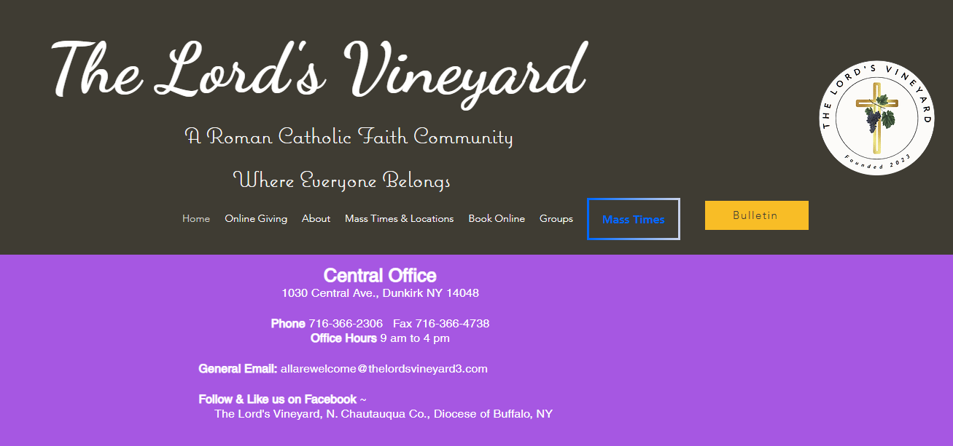
thelordsvineyard3.com

Slide 5
Select under Groups Faith Formation

Slide 6
Select High School Under Groups

Slide 7
Classes meet Sunday mornings
8:45-9:45
Following the printed calendar
Results from the survey that was provided to families with currently enrolled students
1st 8:00 am 2nd 9:00 am 3rd 10:00 am

Slide 8
Confirmation I and II

Slide 9
Confirmation I and II
Confirmation 1 is for those in 9th grade or who are in high school and did not attend faith formation last year.
Confirmation II are the students from last years Confirmation I class

Slide 10
Confirmation I Class will be taught again by Mr. Daniel Quagliana.
Students will receive a drawstring bag that will have all of their materials for class.
They need to bring the bag to each class.
I will use the Remind App, and the website for information regarding their class.
The Remind class is @tlvco to 81010 for Confirmation 1 only. This will be used for class specifics.
Contact me if you are having any trouble, your student will be absent or if you have any questions. You can continue to text me 716-581-1879
Course work that was covered in class when absent can be accessed on the website and they can write out their answers in their journals and turn it in at the next class.
Confirmation I and II students will be receiving their Service booklets. We are all called to do God’s work. A copy of the booklets can be found on the website for high school.
It is their responsibility to not lose their booklet and to have the adult in charge of the service to sign off.
The Sacrament of Confirmation will take place in the spring of 2026
Any questions from Confirmation I families that is not single student specific?
Thank you for coming and I look forward to seeing your students Oct. 20.
Confirmation II parents please stay for a brief discussion.

Slide 11
Confirmation II
Students who were recently confirmed talked to your students after their retreat. They wanted to give them a peer perspective on the retreat to ease their uncertainty.
The students will have 3 choices to vote from.
Camp Turner in Alleghany State Park, owned by Our Lady of Victory
Dunkirk Conference Center
Cradle Beach
Fr. Bob contacted me and let me know that Fr. Paul from Jamestown invited our students to join them at Camp Turner March 21-22 for the retreat.
Originally, I set aside April 3-4 as our retreat time.
The kids will still get to vote, but this would be a great opportunity on so many levels. More kids, more chaperones, another priest and it will be cheaper.
There will be a bus that will pick our kids up if we go and it will bring them back.
Our Sacrament of Confirmation will be sometime next spring. The DOB sets the date. When we know I will pass along the information to you.
Text @tlvcon to 81010 for Conf II class reminders.

Slide 12
www.campturner.com/rentals
RENTALS | Camp Turner

Slide 13
Home - Cradle Beach
www.cradlebeach.org

Slide 14
Dunkirk Camp & Conference Center | Camping Point | Conference Meets | Lakeshore Dr. Dunkirk, New York (dunkirkcc.com)
Facility Tour | Rental Information | Lakeshore Dr. Dunkirk, New York | Dunkirk Camp & Conference Center (dunkirkcc.com)

